Slide 1
PROJECT:1
LOAN MANAGEMENT SYSTEM
Using MYSQL SERVER
By Niraja P G

Slide 2
Loan Data Analysis Summary
Overview of the Data in the Excel File:
The Excel file contains multiple sheets related to loan management, including customer
income status, loan status, customer information, country and state data, and region
information.

Slide 3
DATA SET (Tables)
Following Data sets were used in this Project
Customer Income Status
Loan Status
Customer Info
Country State
Region Info

Slide 4
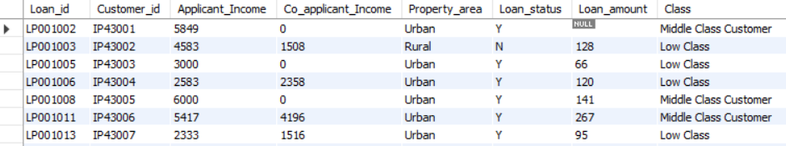
Customer Income Status
Content:
Grading Criteria for Applicants:
Applicant income > 15,000: Grade A
Applicant income > 9,000: Grade B
Applicant income > 5,000: Middle Class Customer
Applicant income ≤ 5,000: Low Class Monthly
Syntax:
SELECT *, IF (Applicant_income >15000, 'Grade_A', IF(Applicant_income >9000, 'Grade_B', IF(Applicant_income >5000, concat('Middle Class Customer'), concat('Low Class')))) AS Class FROM Customer_income_status;
Output:
Result:
We have created a new Column containing “Class” of the customer based on Applicant Income.

Slide 5
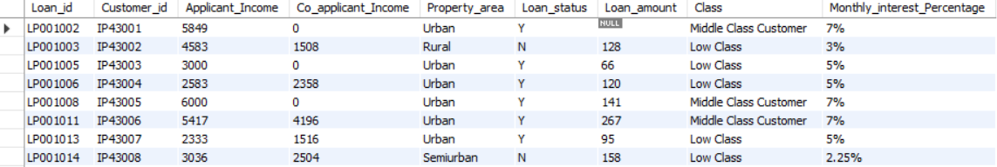
Monthly Interest Percentage Calculation:
Applicant income < 5,000:Rural: 3%
Semi-Rural: 3.5%Urban: 5%
Semi-Urban: 2.5%
Otherwise: 7%
Syntax:
SELECT* ,CASE
WHEN Applicant_income < 5000 AND Property_area = 'rural' THEN Concat('3%')
WHEN Applicant_income < 5000 AND Property_area = 'semirural' THEN concat('3.5%')
WHEN Applicant_income < 5000 AND Property_area = 'urban' THEN concat('5%')
WHEN Applicant_income < 5000 AND Property_area = 'semiurban' THEN concat('2.25%')
ELSE concat('7%')
END AS Monthly_interest_Percentage FROM Customer_income_status1;
Output:
Result:
We have created new column “Monthly Interest Percentage” based on Applicant Income and Property Area.

Slide 6
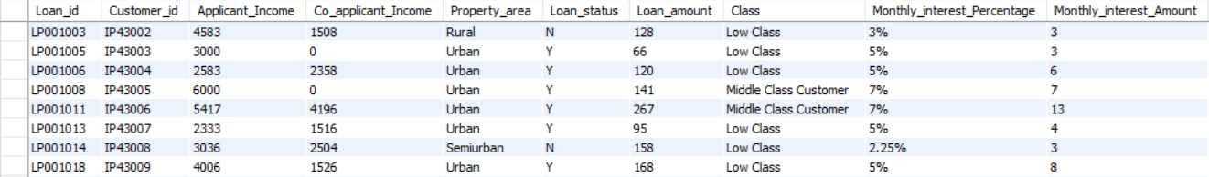
New field creation based on interest
Content:
Monthly Interest and Annual Interest Amount Calculation:
Calculate Monthly Interest Amount and Annual Interest Amount based on Loan Amount
Syntax:
SELECT*,
CASE
WHEN Property_area = 'rural' THEN Floor(Loan_amount*0.03)
WHEN Property_area = 'semirural' THEN floor(Loan_amount *0.035)
WHEN Property_area = 'urban' THEN floor(Loan_amount*0.05)
WHEN Property_area = 'semiurban' THEN floor(Loan_amount *0.025)
ELSE floor(Loan_amount *0.07)
END AS Monthly_interest_Amount FROM Customer_income_status2;
Output:
Result:
We have added a New column “Monthly Interest Amount” based on Loan amount.

Slide 7
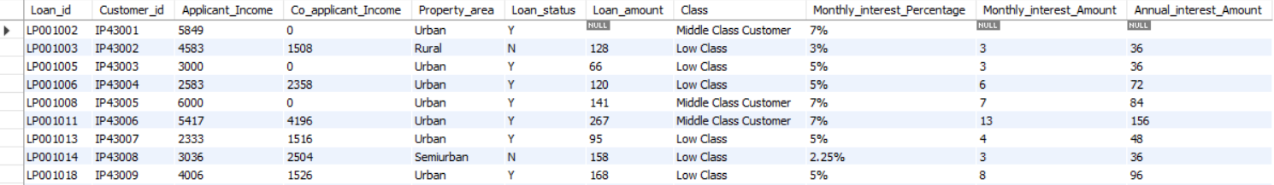
Annual Interest Amount:
SELECT*, Monthly_interest_Amount*12 AS Annual_interest_Amount FROM Customer_income_status3 ;
Output:
Result:
Added New Column “Annual Interest Amount” based on Monthly Interest
NOTE:
We need to Create Separate tables in order to Join new column in the tables. This can be done with the help of “SELF JOIN”.
Syntax for Self join;
CREATE TABLE table name as copy paste the query you want to join
Example:
CREATE TABLE Customer_income_status4 AS SELECT *, Monthly_interest_Amount*12 AS Annual_interest_Amount FROM Customer_income_status3 ;

Slide 8
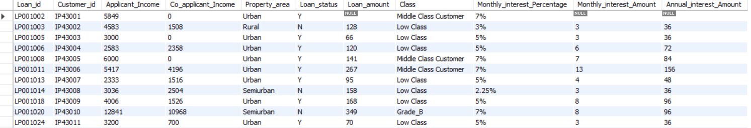
Create all the above fields as a table and name the table Customer Interest Analysis
Syntax:
CREATE TABLE Customer_interest_analysis AS SELECT*, Monthly_interest_Amount*12 AS Annual_interest_Amount FROM Customer_income_status3 ;
Output:
Result:
Created a New table with the help Self Join resulting New Column’s namely “Monthly Interest Percentage”, “Monthly
Interest Amount” and “Annual Interest Amount”.

Slide 9
Create a ROW LEVEL TRIGGER for Loan amount:
Syntax:
CREATE TABLE Loan_status (Loan_id Text, Customer_id VARCHAR (25) Primary KEY, Loan_amount Varchar (25), Loan_amount_Term INT, Cibil_score INT);
Trigger Syntax
DELIMITER ##
CREATE TRIGGER Loan_verify BEFORE INSERT ON loan_statusFOR EACH ROW
BEGIN
IF NEW.loan_amount IS NULL THEN
SET NEW.loan_amount = concat('Loan still processing');
END IF;
END ##DELIMITER ;

Slide 10
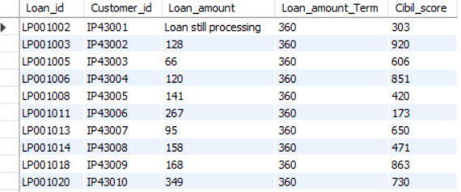
INSERT INTO Loan_status VALUES
('LP001002', 'IP43001’, Null, 360, 303),
('LP001003', 'IP43002’, 128, 360, 920),
('LP001005', 'IP43003’, 66, 360, 606),
('LP001006', 'IP43004’, 120, 360, 851),
('LP001008', 'IP43005’, 141, 360, 420),
('LP001011', 'IP43006’, 267, 360, 173),
Output:
Result:
Creating a row level trigger we have replaced “Null” with “Loan Still Processing”.

Slide 11
Create a STATEMENT LEVEL TRIGGER for CIBIL SCORE:
Syntax:
CREATE TABLE Loan_status1 (Loan_id Text, Customer_id VARCHAR (25) Primary KEY, Loan_amount TEXT, Loan_amount_Term INT, Cibil_score INT);
CREATE TABLE Cibil_score_status (Customer_id VARCHAR(25), Cibil_status Text);
Trigger Syntax:
DELIMITER ##
CREATE TRIGGER cibil_score_verify AFTER INSERT ON Loan_status1 FOR EACH ROW
BEGIN
IF NEW.cibil_score > 900 THEN INSERT INTO Cibil_score_status(Customer_id , Cibil_status ) VALUES (new.Customer_id, Concat('High CIBIL score'));
ELSE IF NEW.cibil_score > 750 THEN INSERT INTO Cibil_score_status(Customer_id , Cibil_status ) VALUES (new.Customer_id, Concat('No penalty')); ELSE IF NEW.cibil_score > 250 THEN INSERT INTO Cibil_score_status(Customer_id , Cibil_status ) VALUES (new.Customer_id, Concat('Penalty customer')); ELSE IF NEW.cibil_score <= 0 THEN INSERT INTO Cibil_score_status(Customer_id , Cibil_status ) VALUES (new.Customer_id, Concat('Reject customer')); END IF;
END IF;
END IF;
END IF;
END ##
DELIMITER ;

Slide 12
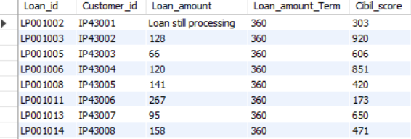
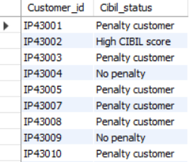
Insert Into Loan_status1 VALUES ('LP001002', 'IP43001', 'Loan still processing', 360, 303), ('LP001003', 'IP43002', 128, 360, 920), ('LP001005', 'IP43003', 66, 360, 606), ('LP001006', 'IP43004', 120, 360, 851), ('LP001008', 'IP43005', 141, 360, 420), ('LP001011', 'IP43006', 267, 360, 173), ('LP001013', 'IP43007', 95, 360, 650), ('LP001014', 'IP43008', 158, 360, 471); Output 1 : Output 2: Result: With Statement Level trigger we have assigned “Cibil Status” with the help of “Cibil Score”.

Slide 13
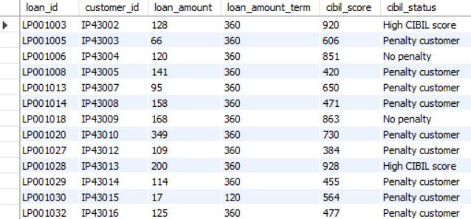
Delete Reject and Loan still processing customers
Syntax:
DELETE FROM Loan_cibil_statusWHERE cibil_status = 'Reject customer' OR loan_amount = 'Loan still processing’;
Output:
Result:
After Deleting Reject and Loan still processing customers it shows the balance rows which are not affected.
Output:

Slide 14
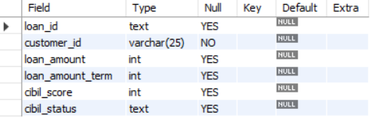
Alter table to change loan_amount to INT
Syntax:
ALTER TABLE Loan_cibil_status MODIFY COLUMN loan_amount INT;
Output:
Result:
We have modified the data type of the column “ Loan_amount”.

Slide 15
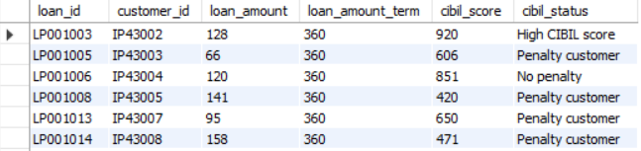
Create all the above fields as a table and Table name - loan cibil score status details
Syntax:
SELECT l.loan_id,l.customer_id,l.loan_amount,l.loan_amount_term,l.cibil_score,c.cibil_statusFROM loan_status1 l join cibil_score_status c On l.customer_id = c.customer_id;
CREATE TABLE Loan_cibil_status_details as SELECT l.loan_id,l.customer_id,l.loan_amount,l.loan_amount_term,l.cibil_score,c.cibil_statusFROM loan_status1 l join cibil_score_status c On l.customer_id = c.customer_id;
SELECT * FROM loan_cibil_status;
Output:
Result:
We have Created a new Table by adding Two new columns named it as “Loan cibil score status”.

Slide 16
Update Gender and Age based on Customer id
Syntax:
UPDATE customer_info
SET gender = CASE
WHEN customer_id = 'IP43006' THEN 'female’
WHEN customer_id = 'IP43016' THEN 'female’
WHEN customer_id = 'IP43018' THEN 'female’
WHEN customer_id = 'IP43038' THEN 'female’
WHEN customer_id = 'IP43508' THEN 'female’
WHEN customer_id = 'IP43577' THEN 'female’
WHEN customer_id = 'IP43589' THEN 'female’
WHEN customer_id = 'IP43593' THEN 'female’
WHEN customer_id = 'IP43018' THEN 'male’
WHEN customer_id = 'IP43038' THEN 'male’
ELSE gender -- Default to current value if no match
END,
age = CASE
WHEN customer_id = 'IP43007' THEN 45
WHEN customer_id = 'IP43009' THEN 25
ELSE age -- Default to current value if no match
END;

Slide 17
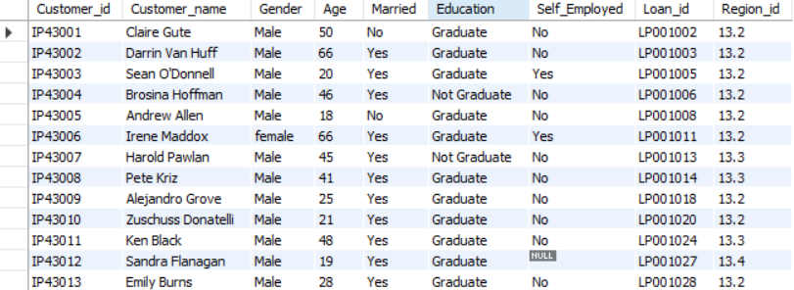
Output:
Result:
Updated Gender and age to specified Customer Id’s.

Slide 18
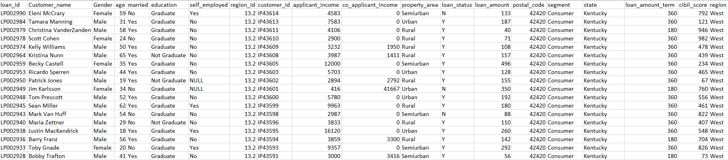
Join all the 5 tables without repeating the fields
Syntax:
SELECT d.loan_id,d.Customer_name,d.Gender,d.age,d.married,d.education,d.self_employed,d.region_id,m.customer_id,m.applicant_income,m.co_applicant_income,m.property_area,m.loan_status,m.loan_amount, c.postal_code,c.segment,c.state,l.loan_amount_term,l.cibil_score,r.regionFROM customer_info d JOIN customer_income_status m On d.loan_id = m.loan_id Join Country_state c On c.Region_id = d.Region_id JOIN loan_status l On l.loan_id = d.loan_id Join Region r On r.region_id = d.region_id;
Output:
Result:
With the help of Join’s we have connected all the five table and created it as a New table.

Slide 19
Find the Mismatch details using joins
Syntax:
SELECT * FROM country_state RIGHT JOIN Region ON country_state.region_id = Region.region_id WHERE country_state.Region_id is NULL;
Output:
Result:
Found the mismatched Field with the help of Join.

Slide 20
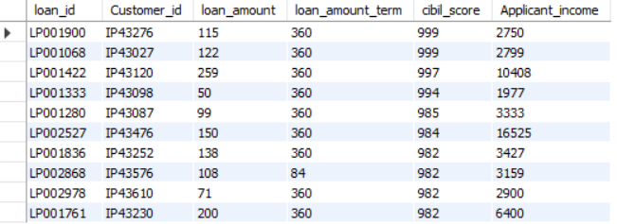
Filtering information using Inner join
Filter high cibil score
Syntax:
SELECT l.loan_id,l.Customer_id,l.loan_amount,L.loan_amount_term,l.cibil_score,c.Applicant_incomeFROM Loan_status lINNER JOIN customer_income_status c ON L.Loan_id = c.Loan_id order by Cibil_score DESC;
Output:
Result:
We have Filtered the High cibil score by joining Two Tables.

Slide 21
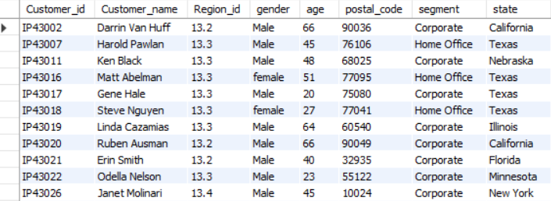
Filter Home-office and Corporate
Syntax:
SELECT S.Customer_id,s.Customer_name,s.Region_id,c.gender,c.age,s.postal_code,s.segment,s.stateFROM Country_state s Inner Join customer_info c On s.Customer_id = c.Customer_id WHERE Segment In ('Home office', 'Corporate’) ;
Output:
Result:
By joining the Two tables filtered “ Home- Office” and “Corporate” from the table.

Slide 22
Store all the outputs as Procedure
Syntax:
DELIMITER ##
CREATE PROCEDURE Project_data()
BEGIN
SELECT d.loan_id,d.Customer_name,d.Gender,d.age,d.married,d.education,d.self_employed,d.region_id,m.customer_id,m.applicant_income,m.co_applicant_income,m.property_area,m.loan_status,m.loan_amount, c.postal_code,c.segment,c.state,l.loan_amount_term,l.cibil_score,r.regionFROM customer_info d JOIN customer_income_status m On d.loan_id = m.loan_id Join Country_state c On c.Region_id = d.Region_id JOIN loan_status l On l.loan_id = d.loan_id Join Region r On r.region_id = d.region_id;
SELECT l.loan_id,l.Customer_id,l.loan_amount,L.loan_amount_term,l.cibil_score,c.Applicant_incomeFROM Loan_status lINNER JOIN customer_income_status c ON L.Loan_id = c.Loan_id order by Cibil_score DESC LIMIT 0,10;
SELECT * FROM country_state RIGHT JOIN Region ON country_state.region_id = Region.region_id WHERE country_state.Region_id is NULL;
SELECT S.Customer_id,s.Customer_name,s.Region_id,c.gender,c.age,s.postal_code,s.segment,s.stateFROM Country_state s Inner Join customer_info c On s.Customer_id = c.Customer_id WHERE Segment In ('Home office', 'Corporate’) ;
END ##
DELIMITER ;

Slide 23
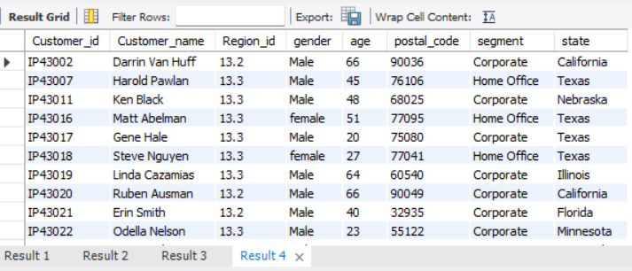
To View of the Output of the Procedure
CALL project_data();
It Shows all the 4 Queries output in a single click.
Output:
Result:
We have created a Query using Procedure and stored 4 queries and when we call the procedure it showed all the 4 queries output in a single click.

Slide 24
Results and Insights
High Cibil Score Customers:
A list of customers with a Cibil score higher than 900, indicating good creditworthiness.
Joined Customer Data:
Combined information from all tables, providing a comprehensive view of each customer, their income status, loan details, and geographic information.

Slide 25
Conclusion
Effective categorization of customers based on income allows for better-targeted loan offers. Implementing triggers ensures data integrity and proper categorization of loan statuses.
Using stored procedures facilitates efficient data retrieval and analysis.

Slide 26
Thank You

